Slide 1

Internship Report
Name: Nguyen Tran Gia Huy
Student’s ID: 20520106
Class: KHBC2020
Internship Company: Minh Phuc Telecom

Slide 2

Introductions
I have been given the opportunity to work on 2 projects with different team members and the working experience has been wonderful.
Comments on internship program (Strength):
Python and Power BI (Data Analysis)
Prometheus and Grafana (Show status of devices and management)

Slide 3
Content
1. About the company
General information
Leadership
Field of activity
2. Plans and assigned work
Internship position
Jobs
3. Work content
Project 1: Reporting departments monthly
Project 2: Reporting the Interface status of Switch and Bandwidth Information by using Prometheus and Grafana.
4. Experience after internship program

Slide 4


Minh Phuc Telecom
1. About the company
General information
Leadership
Field of activity

Slide 5

General Information
MP Telecom was established in 2002, which is is a leading company in Vietnam specializing in providing Solutions - Contact Center services and Business Process Outsourcing – BPO.
Leadership
Head of IT department: Mr Le Minh Tien
Field of activity
Services of MP Telecom:
Customer Care
Tele-Services
HR Supply & Training
.....

Slide 6
2. Plans and assigned
Internship
IT Support Intern
Internship period
Started on 14/3/2022 and end in 14/6/2022
Part-time intern
Jobs
Project 1: Reporting departments monthly by using Power BI.
Project 2: Creating two diagrams which illustrate Port Satus Up or Down and Admin of Banwidth Information of technological devices by using Prometheus and Grafanas dashboard.

Slide 7

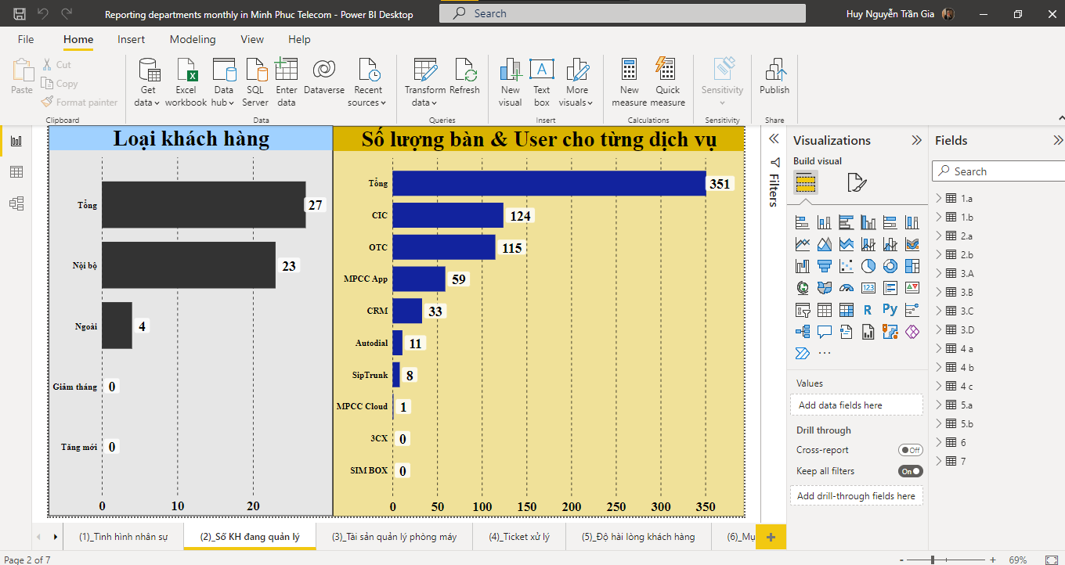
3. Work Content
Project 1: Reporting departments monthly
Notes:
Product Screenshot Full MacBook

Slide 8
Overview of the project.
Creating and separating tables in Excel by using the language: Python
Importing and Exporting database for following requirements by using Diagram Analysis Application: Power BI
The project has to have these basic functions.
Excel: Understanding all valuable information of reporting departments monthly. Besides, using Python to separate tables for analysing explicitly values in each sheet
Power BI: Importing database from excel to Power BI fields. In addition, using query options to count total and average numbers in each column immediately, then using suitable graphs for demonstrating clearly all information values in each diagram.
Notes:
This has never been done before and I’m willwing to undertake this project which is known as the most difficult part of the job

Slide 9
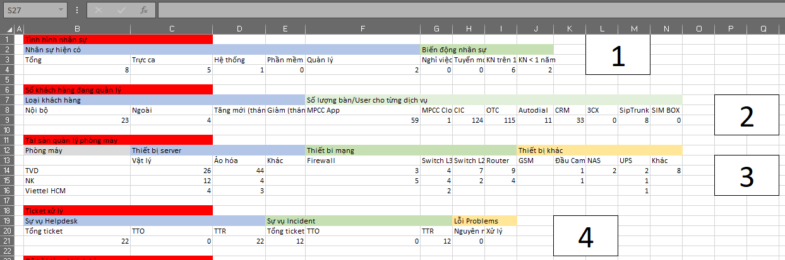
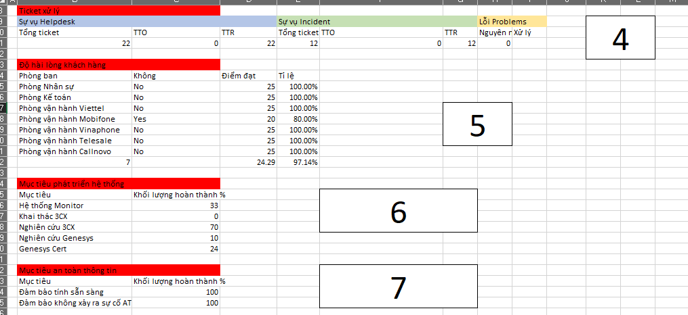
Stage 1
Understanding valuable information and creating character numbers for each group of department status and device information to manage easily.
Notes:
Product Screenshot Full MacBook

Slide 10
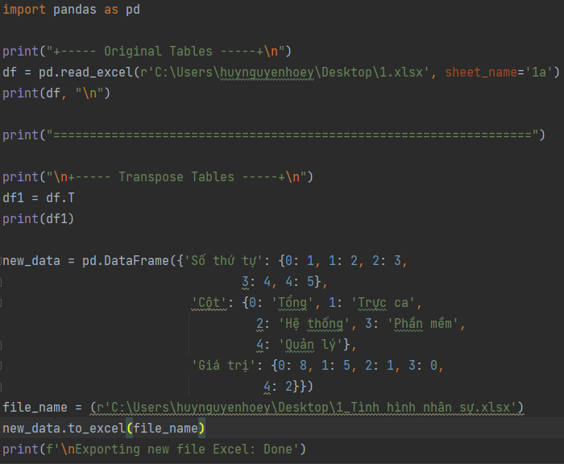
Stage 2
Using Python to separate and transpose from horizontal to vertical tables to analytically clearly data
Notes:
Product Screenshot Full MacBook

Slide 11
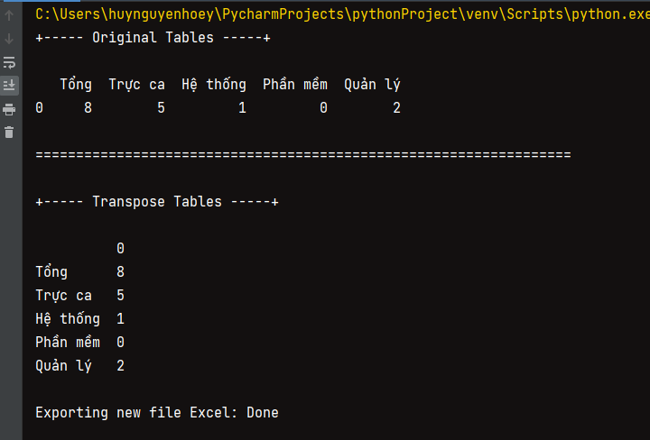
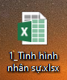
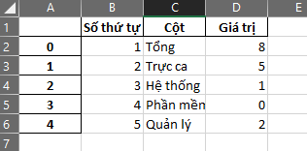
Stage 2
Result
Then, open a new file exporting currently and deleting the first columns of index to make valuable information in table more clearly
Notes:
Product Screenshot Full MacBook

Slide 12
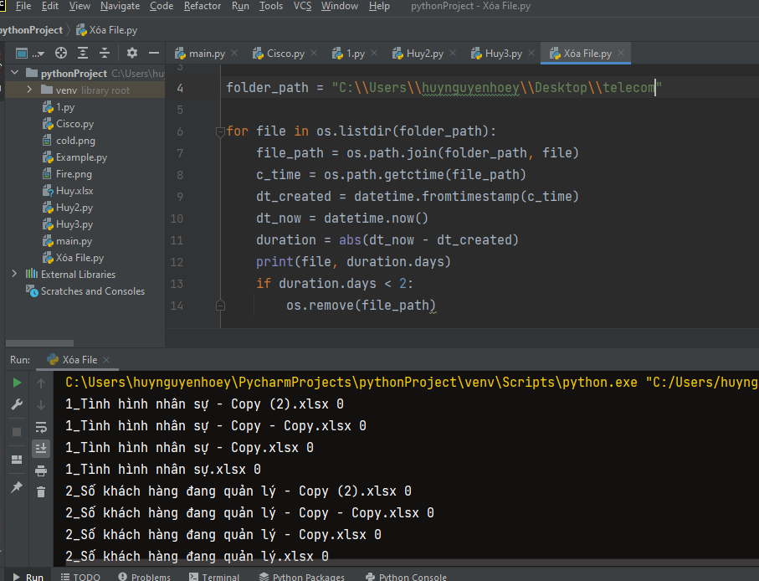
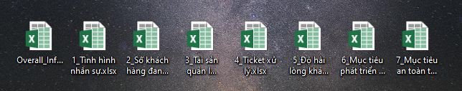
Stage 3
Extra-task
Using Python to delete temporary and copy files for less than 2 days during working period. Finally, just only save all the main files needed to continue working with them.
Result
Notes:
Product Screenshot Full MacBook

Slide 13
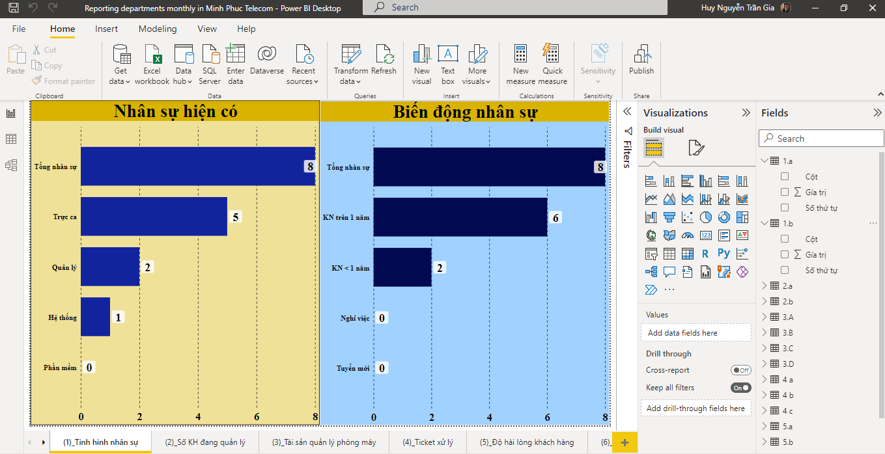
Stage 4
Importing each database into Power BI fields to compare and demonstrate.
Additionally, using query options to count and create a total or average for suitable values with each table, then edit the charts
Notes:
Product Screenshot Full MacBook

Slide 14
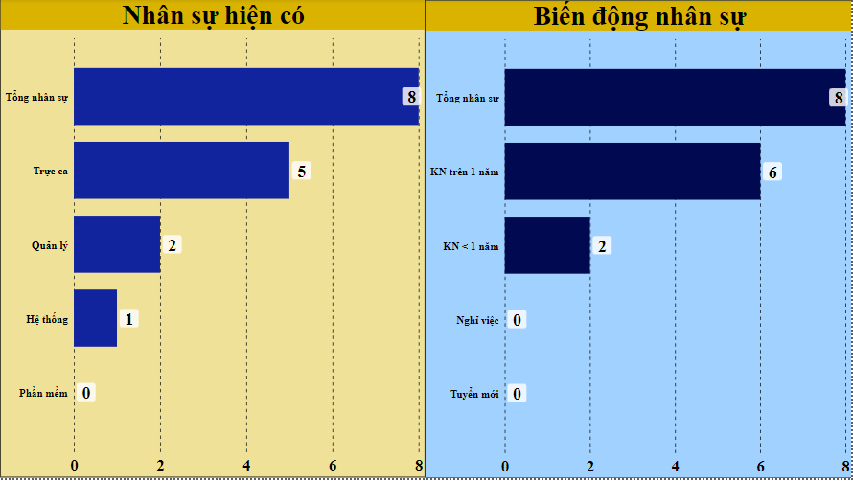
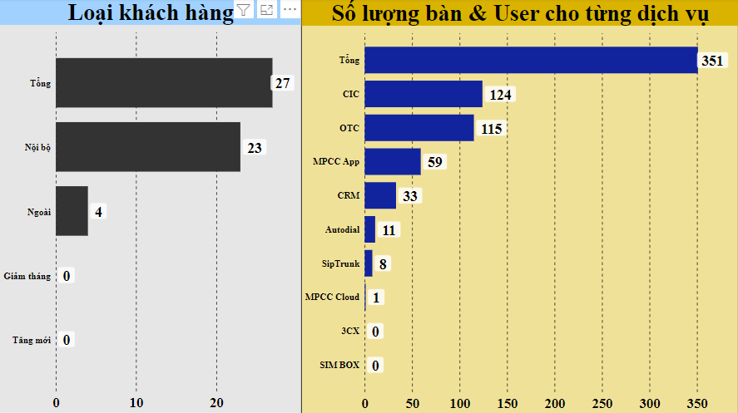
Result of the project 1
Chart 1: Tình hình nhân sự
Chart 2: Số khách hàng đang quản lý

Slide 15
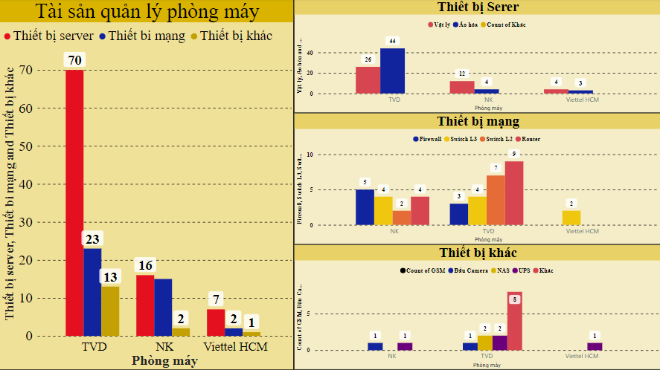
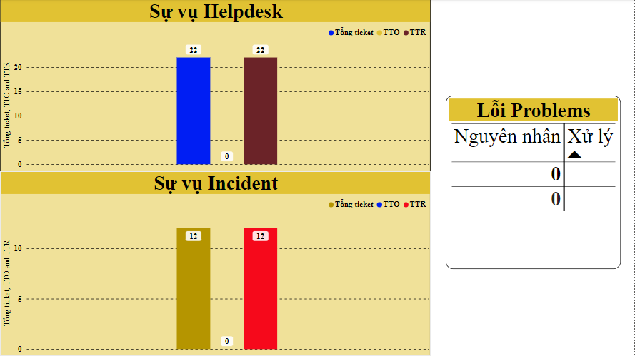
Result of the project 1
Chart 3: Tài sản quản lý phòng máy
Chart 4: Ticket xử lý

Slide 16
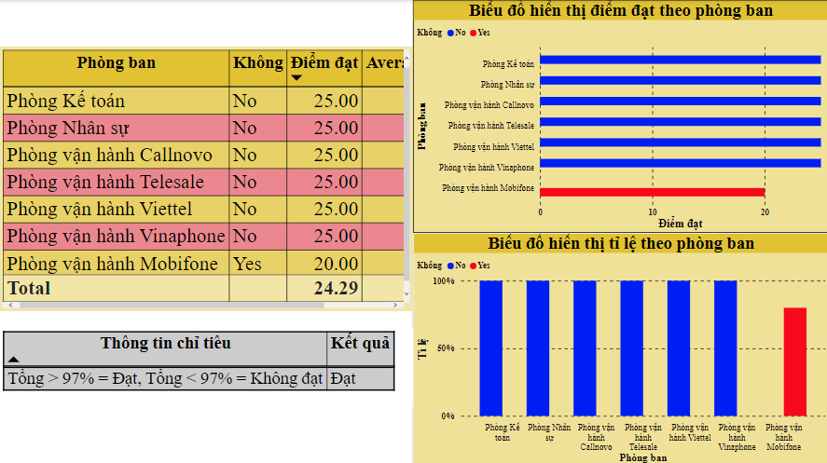
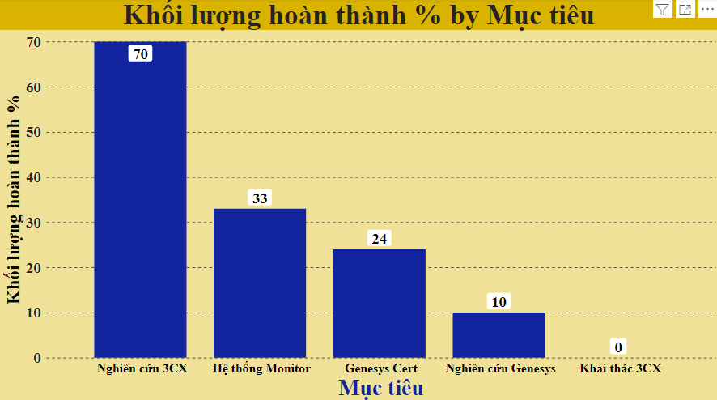
Result of the project 1
Chart 5: Độ hài lòng khách hàng
Chart 6: Mục tiêu phát triển hệ thống

Slide 17
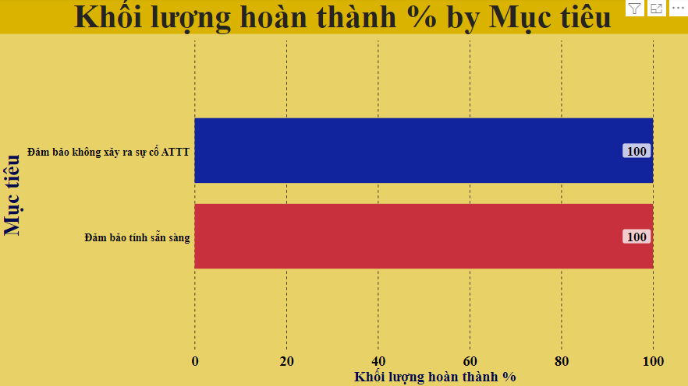
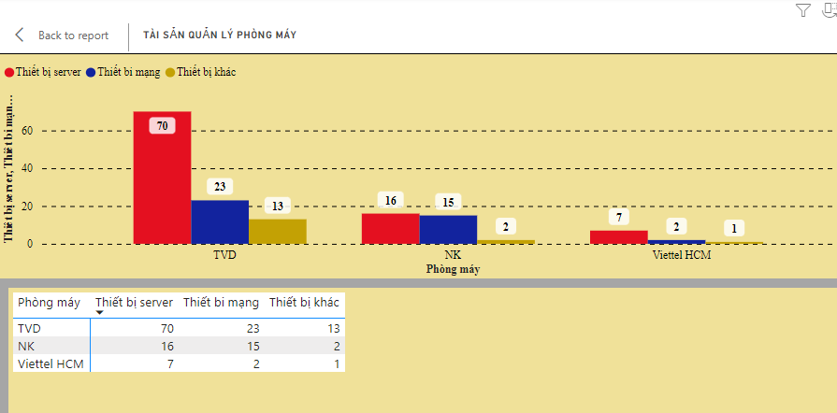
Result of the project 1
Chart 7: Mục tiêu an toàn thông tin
Besides, choosing “show table” in the right corner of the top of the diagram to show all valae mapping with the chart visually.

Slide 18
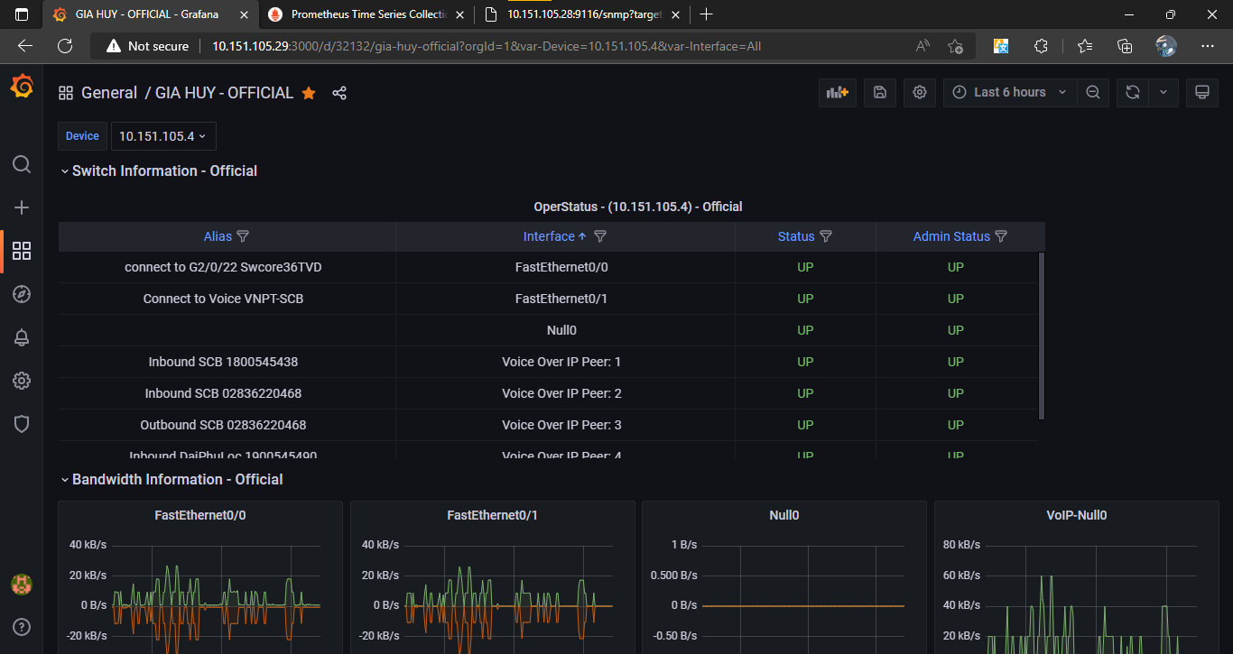


3. Work Content
Project 2: Creating two diagrams which illustrate Port Satus Up or Down and Admin of Banwidth Information of technological devices by using Prometheus and Grafanas dashboard.
Notes:
Product Screenshot Full MacBook

Slide 19
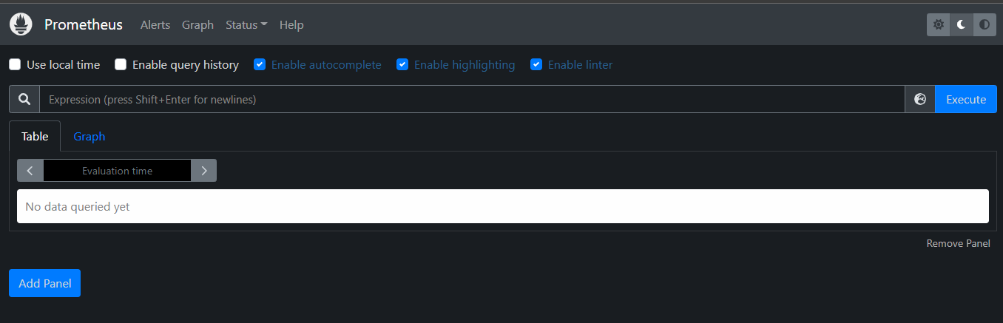
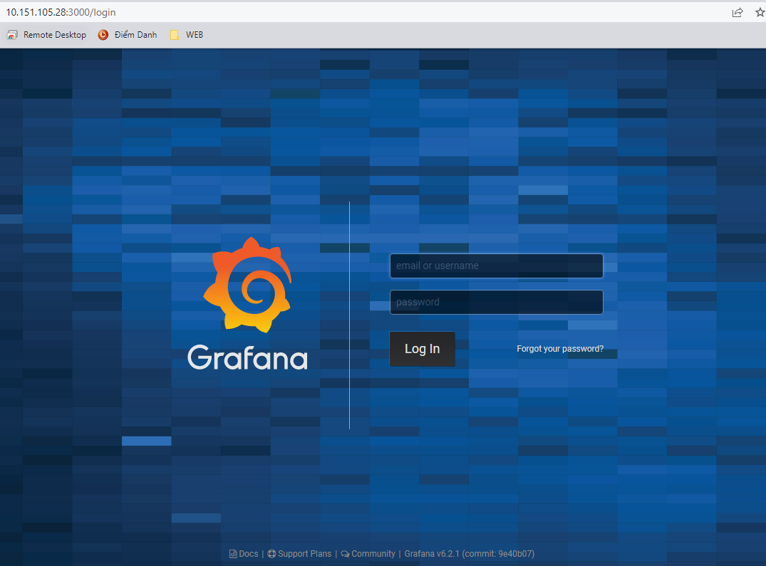
What is Prometheus?
Prometheus is an open-source systems monitoring and alerting toolkit originally built at SoundCloud.
Prometheus scrapes metrics from instrumented jobs, either directly or via an intermediary push gateway for short-lived jobs. It stores all scraped samples locally and runs rules over this data to either aggregate and record new time series from existing data or generate alerts.
(Background of Prometheus)
What is Grafana?
Grafana is an open-source observability platform for visualizing metrics, logs, and traces collected from your applications. It’s a cloud-native solution for quickly assembling data dashboards that let you inspect and analyze your stack.
Grafana connects to a variety of data sources such as Prometheus, InfluxDB, ElasticSearch, and traditional relational database engines.
(Background of Grafana)

Slide 20
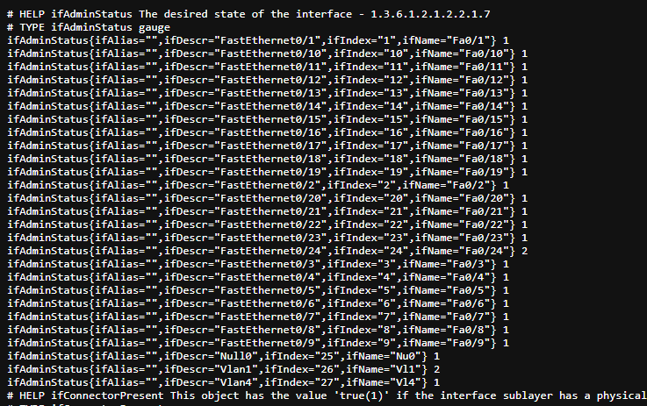
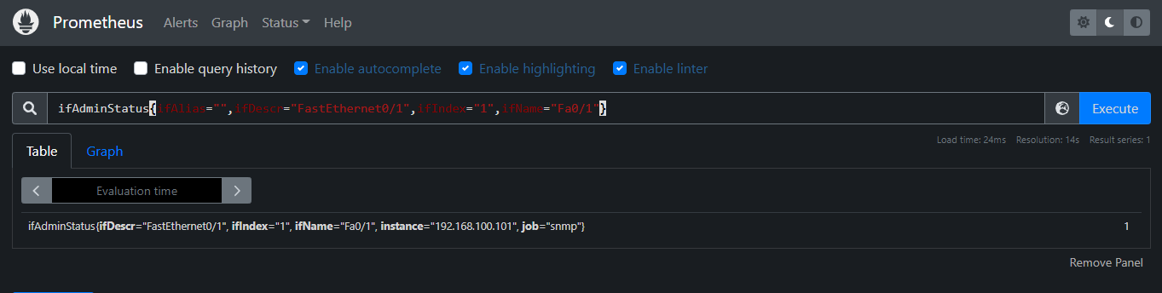
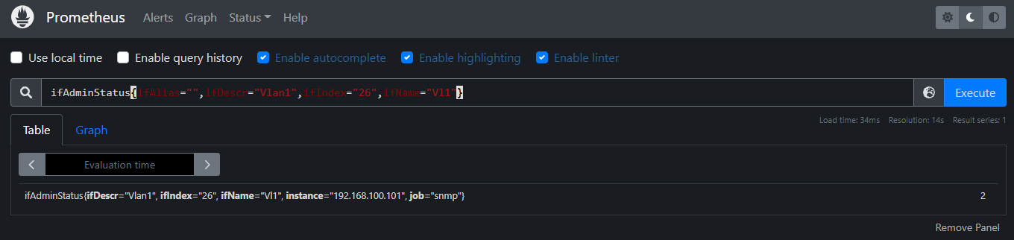
1. “Switch Information – Official” Panel
Step 1: Using code information of AdminStatus from SNMP Exporter and using Prometheus to convert values, which is suitable with Grafana dashboard. Afterwards, we can see the final value “1” in the end, which mean the Switch is “UP” and “2” is “DOWN”.
UP
DOWN
Notes:
Product Screenshot Full MacBook

Slide 21
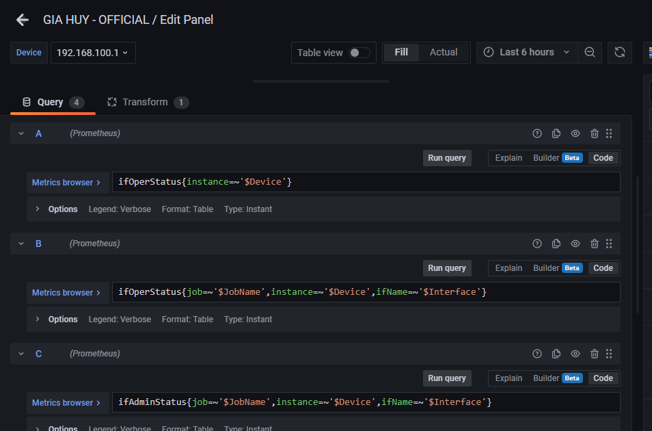
Definitions of valuable information which is important and necessary.
Title
Interface
Device
Step 2: Importing matrics browser into Query of Grafana. Particularly, understanding and searching how to use reasonable codes, then edit options *, which is suitable with the Table has chosen.
*
*
*
Notes:
Product Screenshot Full MacBook

Slide 22
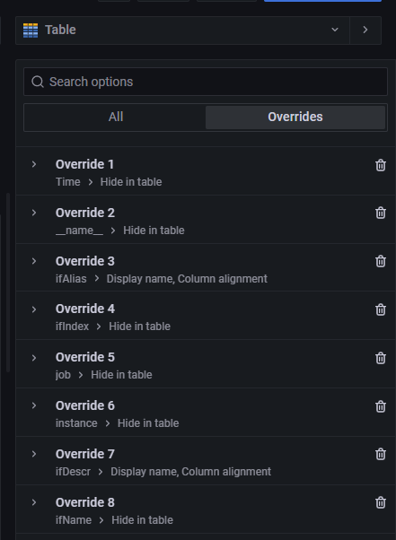
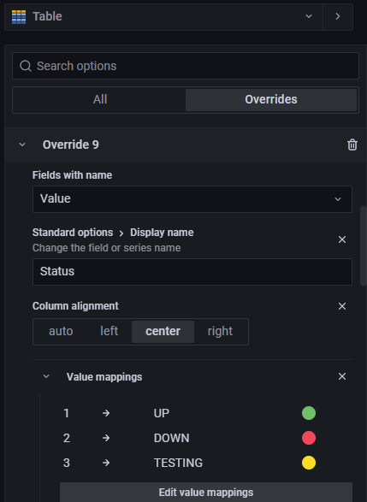
Step 3: Choosing the Table, rename and edit value mappings on the right side of the Grafana Dashboard.
Notes:
Product Screenshot Full MacBook

Slide 23
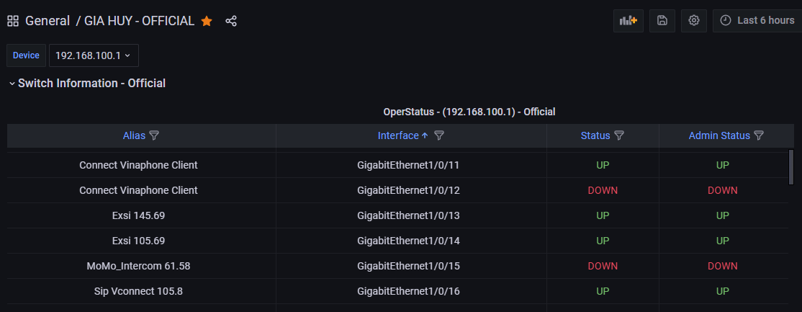
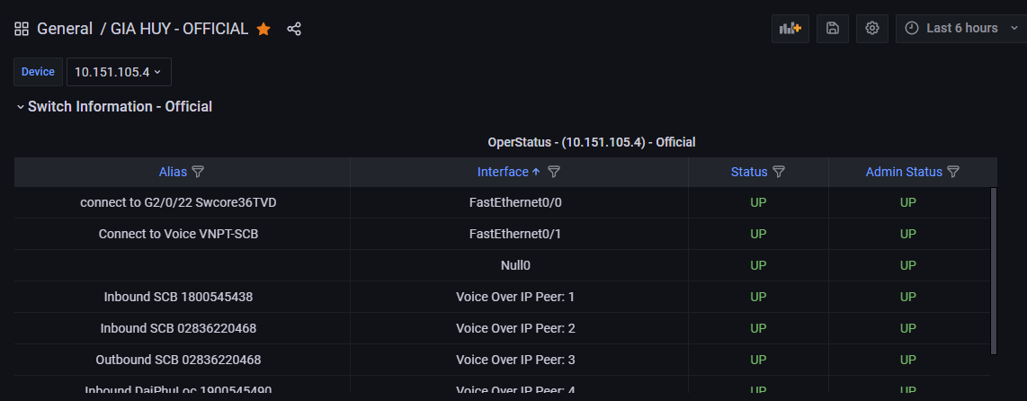
Step 4: Showing the result on the main dashboard.
Choose other devices to check, if it shows values unequivocally, it is a complete success.
Notes:
Product Screenshot Full MacBook

Slide 24
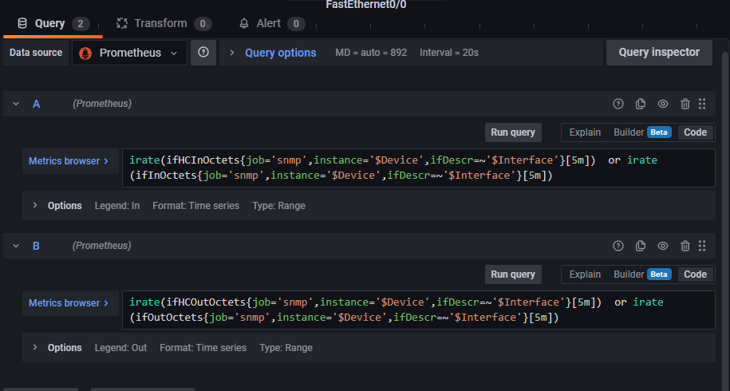
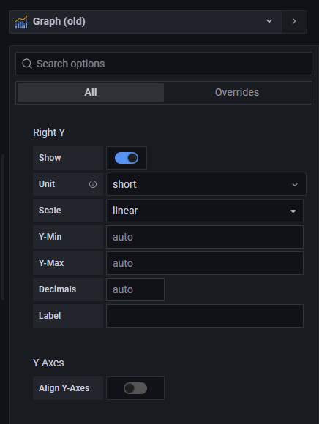
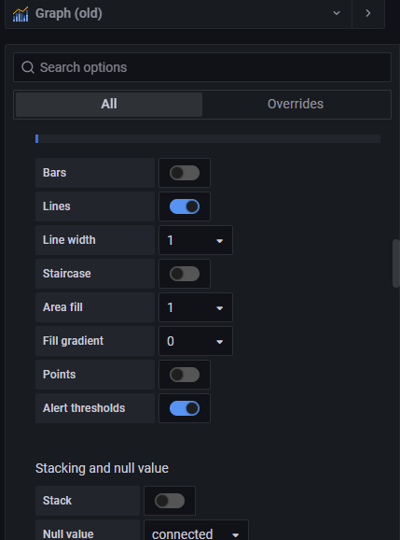
2. “Bandwidth Information – Official” Panel
Step 2
Step 1: Similar to “Switch Information – Official” Panel.
Step 2: Adding “irate” into Metrics browsers of Input and Output to show the rate information clearly of each device in the graph (Old).
Step 3
Step 3
Step 3: Editing value mappings to display in a graph (Old) by the options on the right side of the dashboard.
Notes:
Product Screenshot Full MacBook

Slide 25
Step 4: Showing the result on the main dashboard.
Choose other devices to check, if it shows values unequivocally, it is a complete success.
Notes:
Product Screenshot Full MacBook

Slide 26
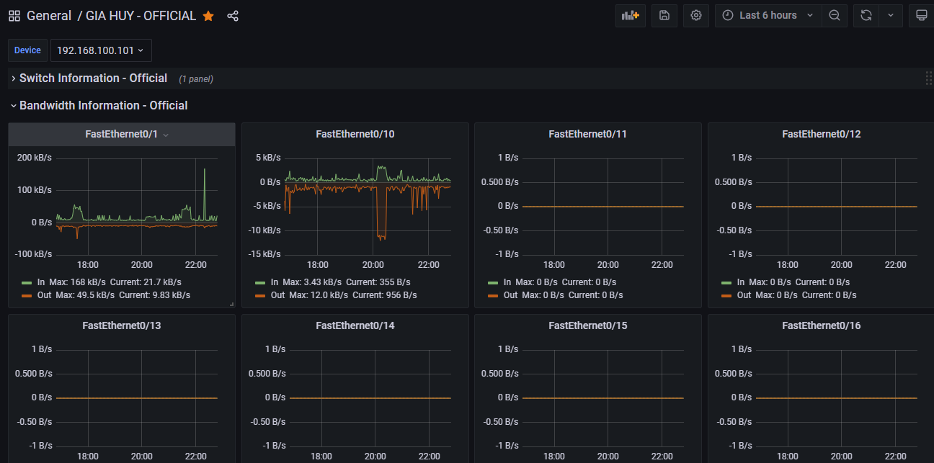
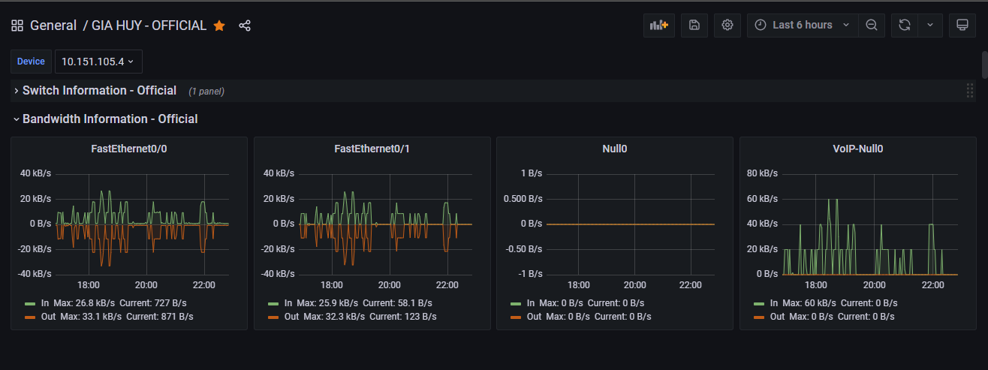
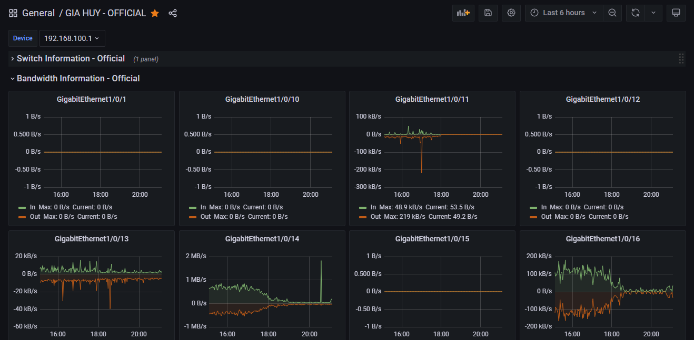
Step 4: Showing the result on the main dashboard.
Choose other devices to check, if it shows values unequivocally, it is a complete success.
Notes:
Product Screenshot Full MacBook

Slide 27
Result of the project 2

Slide 28
4. Experience after internship program
Managing project information and understanding how to process, import, export, delete data, etc by Python and visualising several data sources with charts by Power BI.
Understanding how to work and manage the status of devices in different departments on the Grafana dashboard by using Prometheus. Particularly, learning and understanding how the telecom company successfully operates the management system of devices

Slide 29
Timeline Title
Duration: 14th Mar 2022 – 14th Jun 2022
Month 1
Month 2
Month 3
Project 1
Editing value mappings with suitable charts in Power BI
Double-check and fix mistakes (if any), then write the report
Understanding overview of the data.
Using the Prometheus to convert and analyse data.
Week 1 | Week 2 + 3 | Week 4 | Week 1 + 2 | Week 3 + 4 | Week 1 | Week 2 + 3 | Week 4
Month 1
Month 2
Month 3
Understanding overview of the data in SNMP Exporter
Create panels and show valuable information on the Grafana dashboard.
Using Python to delete draft and temporary files < 2 days. Importing the rest data into Power BI
Using Python to analyse the data to make it more clearly
Project 2

Slide 30

Thank You!

